Slide 1
Association between ABO Blood Types and COVID-19
Presented by Yujia Zhang
Key Words: COVID-19, Coronavirus, 2019-nCoV, ABO blood types, SARS-CoV-2
USC Mark and Mary Stevens Neuroimaging and Informatics Institute
USC Laboratory of Neuroimaging
loni.usc.edu

Slide 2
Coronavirus Pandemic Has Changed Our Lives
Mental health challenges:
Many teens show sign of anxiety and depression
Restrictions of the pandemic: more time isolated from friends, canceling of important social activities, such as sports and graduation.
Staying Healthy During the Pandemic:
More time outdoors or experience nature
Encourage better sleep habits
Keeping communication open while still giving space
Trying a web-based program
https://www.healthline.com/health-news/impact-of-covid-19-lockdown-on-teens-mental-health#How-to-help-anxiety-and-depression-in-teens-during-the-pandemic
USC Mark and Mary Stevens Neuroimaging and Informatics Institute
USC Laboratory of Neuroimaging
loni.usc.edu

Slide 3
Understanding Coronavirus
Why is COVID-19 mild for some, but deadly for others?
Goals:
Summarize findings include associations between ABO blood type and higher infection susceptibility and severe outcomes, including death.
USC Mark and Mary Stevens Neuroimaging and Informatics Institute
USC Laboratory of Neuroimaging
loni.usc.edu

Slide 4
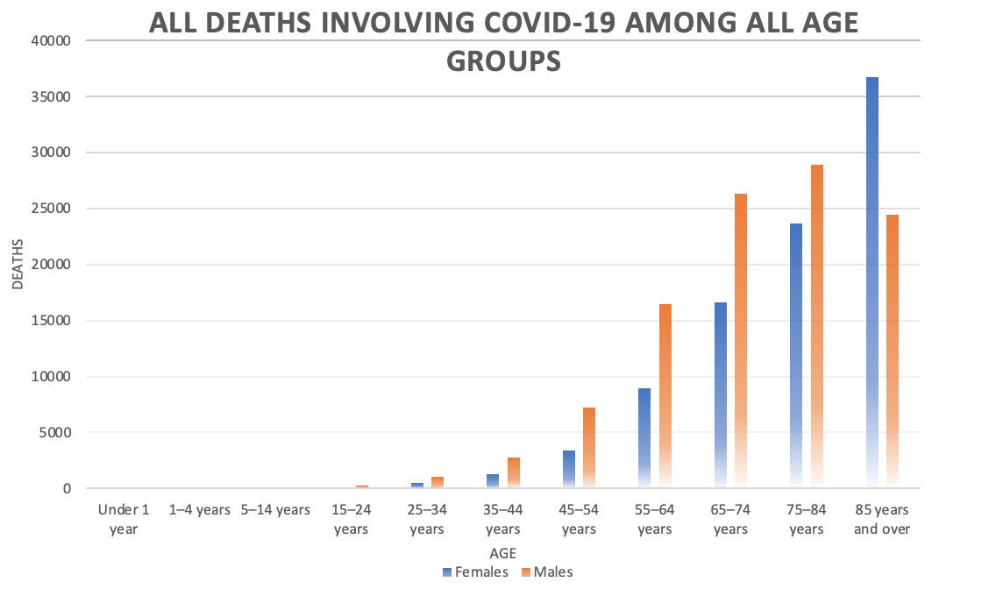
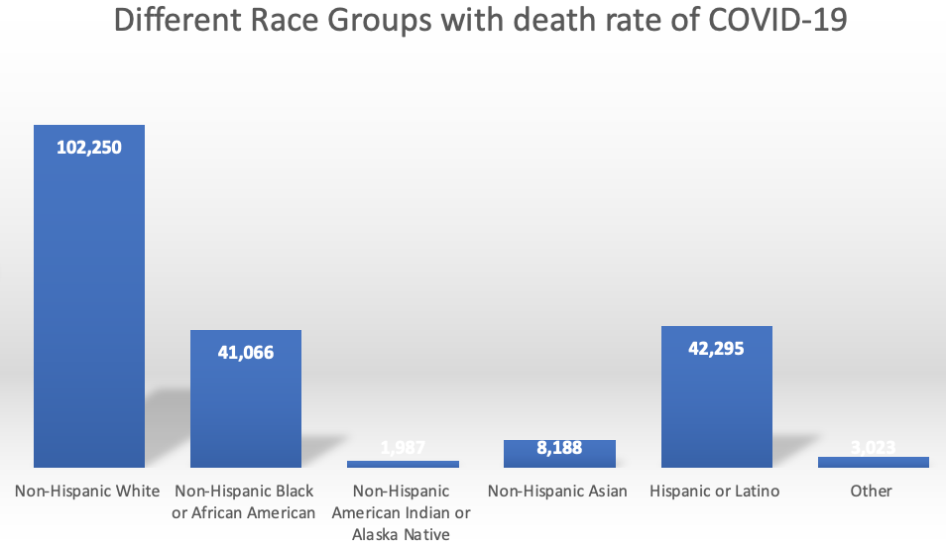
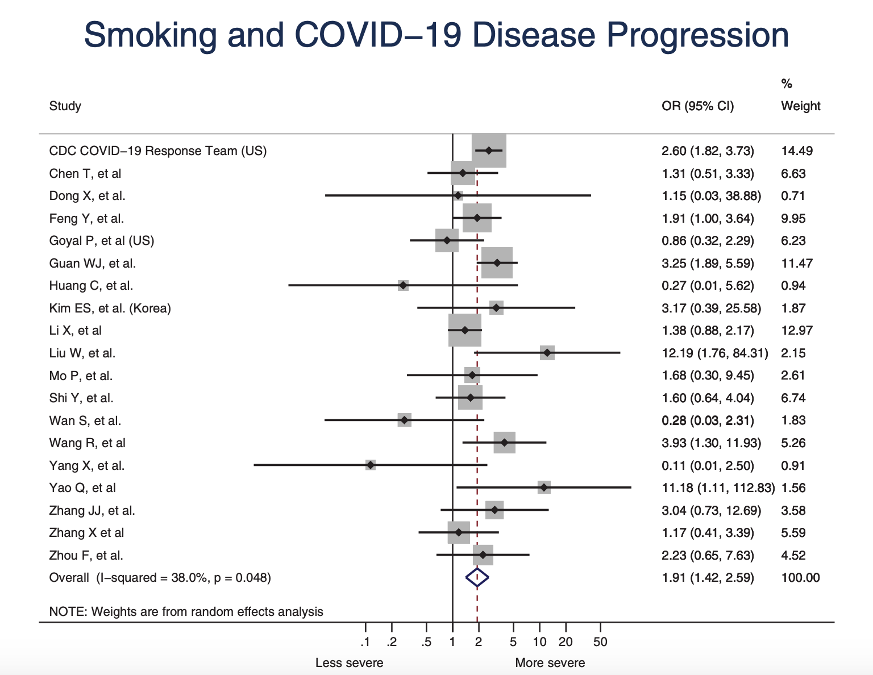
Risk Factors
2. Modifiable risk factors
Can be controlled, manipulated or treated through intervention or lifestyle changes, such as smoking.
Nonmodifiable risk factors
Innate traits, such as ethnicity, age, gender and blood types.
Patanavanich, R., & Glantz, S. A. (2020). Smoking Is Associated With COVID-19 Progression: A Meta-analysis. Nicotine & Tobacco Research, 22(9), 1653–1656. https://doi.org/10.1093/ntr/ntaa082
https://covid.cdc.gov/covid-data-tracker/?CDC_AA_refVal=https%3A%2F%2Fwww.cdc.gov%2Fcoronavirus%2F2019-ncov%2Fcases-updates%2Fcases-in-us.html#cases_casesper100klast7days
USC Mark and Mary Stevens Neuroimaging and Informatics Institute
USC Laboratory of Neuroimaging
loni.usc.edu

Slide 5
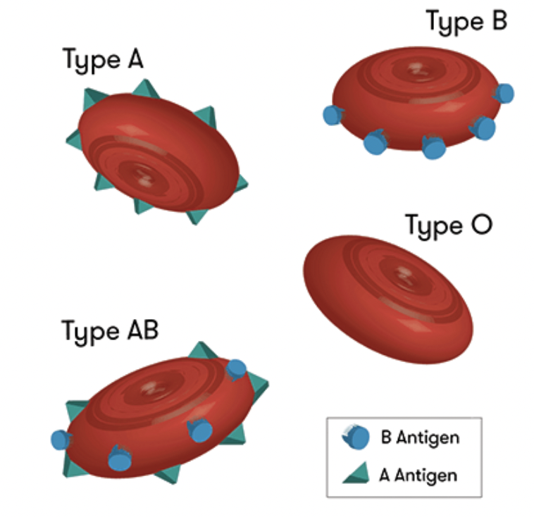
Blood Groups
There are four blood groups:
A type blood has only A antigens on red blood cells
B type blood has only B antigens on red blood cells
AB has both A and B antigens on red blood cells
O has neither A nor B antigens on red blood cells.
https://www.medicalnewstoday.com/articles/218285#abo-and-common-types
https://www.science.org.au/curious/people-medicine/understanding-different-blood-types
USC Mark and Mary Stevens Neuroimaging and Informatics Institute
USC Laboratory of Neuroimaging
loni.usc.edu

Slide 6
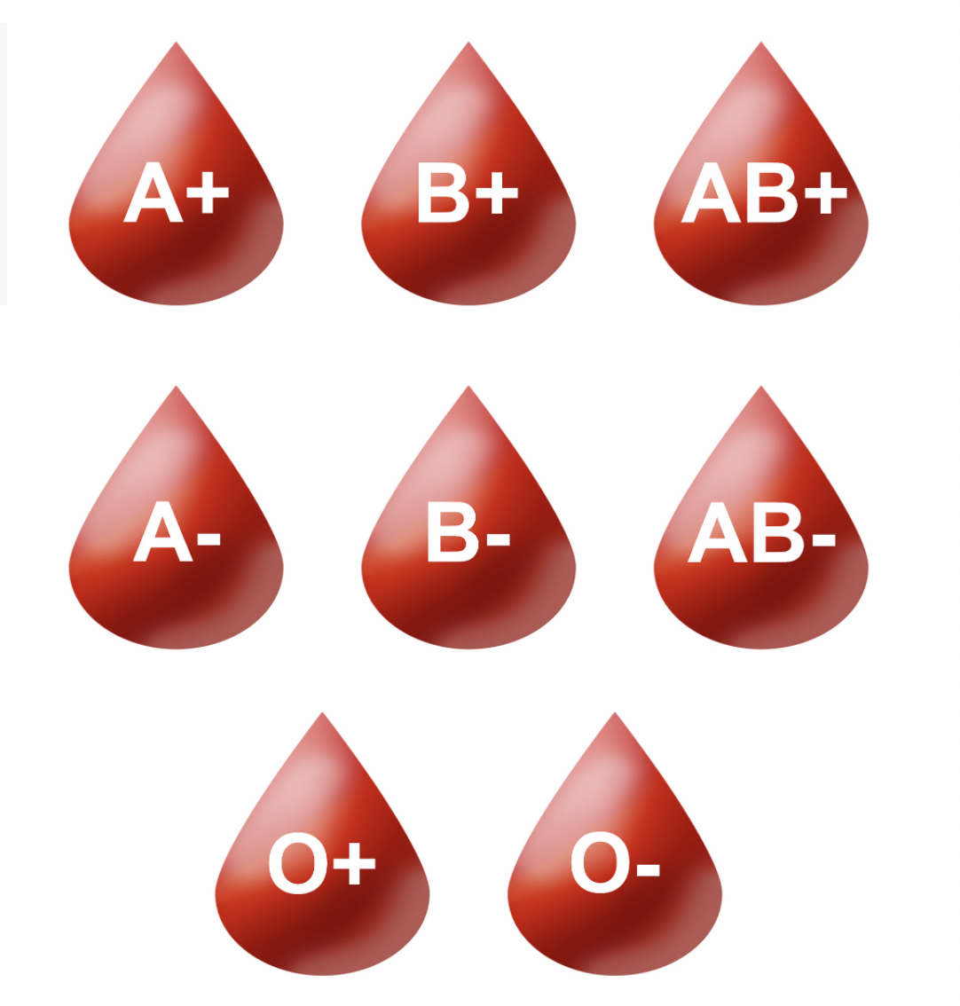
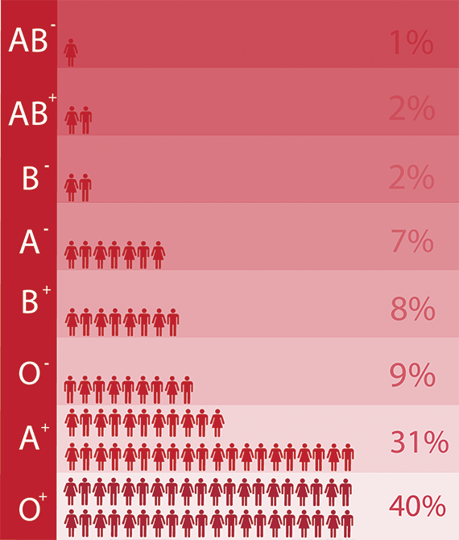
Blood Groups
Like the ABO system, the positive or negative component of your blood type refers to molecules being present or absent on the surface of your red blood cells. The full Rh blood group system includes around 50 different red blood cell antigens, but the most important one is a protein called RhD. If you have the RhD protein on your red blood cells, you’re Rh positive. If you don’t have it, you’re Rh negative.
https://www.medicalnewstoday.com/articles/218285#abo-and-common-types
https://www.science.org.au/curious/people-medicine/understanding-different-blood-types
USC Mark and Mary Stevens Neuroimaging and Informatics Institute
USC Laboratory of Neuroimaging
loni.usc.edu

Slide 7
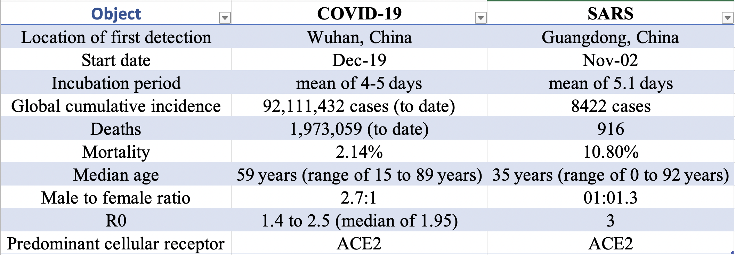
Severe Acute Respiratory Syndrome (SARS) Infection
1. The global SARS outbreak lasted from late 2002 to mid-2003.
2. Both COVID-19 and SARS are caused by coronaviruses. The virus that causes SARS is known as SARS-CoV, while the virus that causes COVID-19 is known as SARS-CoV-2.
Caldaria, Antonio et al. “COVID-19 and SARS: Differences and similarities.” Dermatologic therapy vol. 33,4 (2020): e13395. doi:10.1111/dth.13395

Slide 8
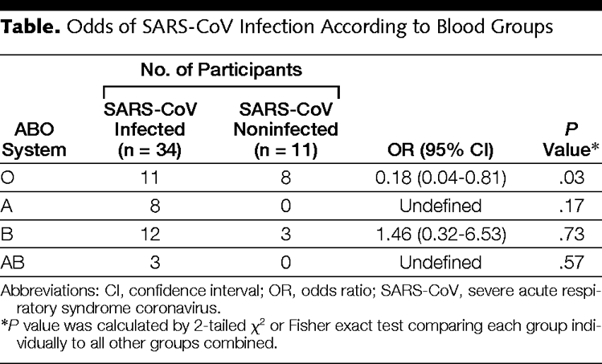
Blood Types Related to Severe Acute Respiratory Syndrome (SARS) Infection
Individuals with type O blood seemed to be less likely to become infected compared to non-blood type O individuals.
Cheng Y, Cheng Y, Cheng G, et al. ABO blood group and susceptibility to severe acute respiratory syndrome. JAMA. 2005;293(12):1450-1451. doi:10.1001/jama.293.12.1450-c
USC Mark and Mary Stevens Neuroimaging and Informatics Institute
USC Laboratory of Neuroimaging
loni.usc.edu

Slide 9
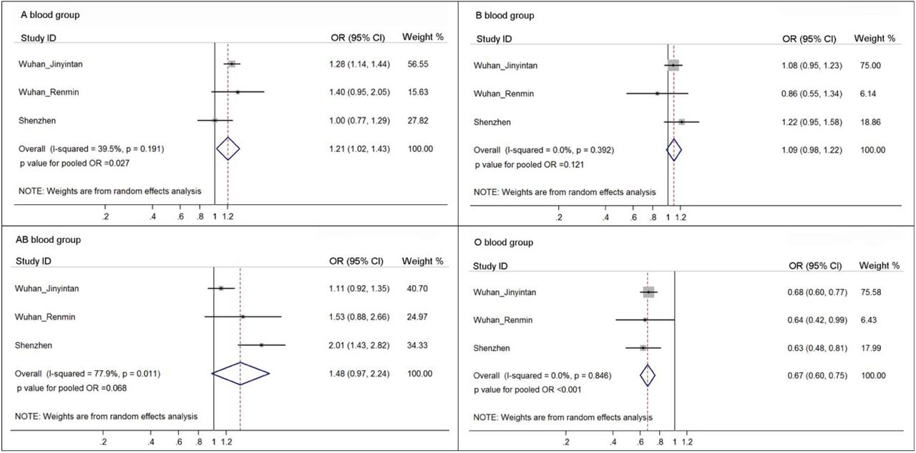
Association between Blood Types with Higher Susceptible of Testing Positive
Individuals with type A and AB blood seems associated with highest probability of infection.
blood type O patients have significantly lower odds of infection, suggesting that blood type O may be a protective factor against infection.
1. Fan Q, Zhang W, Li B, Li D-J, Zhang J, Zhao F. Association Between ABO Blood Group System and COVID-19 Susceptibility in Wuhan. Front Cell Infect Microbiol. 2020;10:404. doi:10.3389/fcimb.2020.00404
2. Zhao J, Yang Y, Huang H, et al. Relationship between the ABO Blood Group and the COVID-19 Susceptibility. Clin Infect Dis Off Publ Infect Dis Soc Am. Published online 2020. doi:10.1093/cid/ciaa1150
3. Golinelli D, Boetto E, Maietti E, Fantini MP. The association between ABO blood group and SARS-CoV-2 infection: A meta-analysis. PloS One. 2020;15(9):e0239508. doi:10.1371/journal.pone.0239508
4. Wu B-B, Gu D-Z, Yu J-N, Yang J, Shen W-Q. Association between ABO blood groups and COVID-19 infection, severity and demise: A systematic review and meta-analysis. Infect Genet Evol J Mol Epidemiol Evol Genet Infect Dis. 2020;84:104485. doi:10.1016/j.meegid.2020.104485
5. Wu Y, Feng Z, Li P, Yu Q. Relationship between ABO blood group distribution and clinical characteristics in patients with COVID-19. Clin Chim Acta Int J Clin Chem. 2020;509:220-223. doi:10.1016/j.cca.2020.06.026
6. Barnkob MB, Pottegård A, Støvring H, et al. Reduced prevalence of SARS-CoV-2 infection in ABO blood group O. Blood Adv. 2020;4(20):4990-4993. doi:10.1182/bloodadvances.2020002657
7. Latz CA, DeCarlo C, Boitano L, et al. Blood type and outcomes in patients with COVID-19. Ann Hematol. 2020;99(9):2113-2118. doi:10.1007/s00277-020-04169-1
8. Zietz M, Zucker JE, Tatonetti NP. Testing the association between blood type and COVID-19 infection, intubation, and death. medRxiv. Published online September 10, 2020:2020.04.08.20058073. doi:10.1101/2020.04.08.20058073
9. Principles of Epidemiology in Public Health Practice, Third Edition, An Introduction to Applied Epidemiology and Biostatistics. Centers for Disease Control and Prevention (CDC). https://www.cdc.gov/csels/dsepd/ss1978/lesson3/section5.html
10. Padhi S, Suvankar S, Dash D, et al. ABO blood group system is associated with COVID-19 mortality: An epidemiological investigation in the Indian population. Transfus Clin Biol J Soc Francaise Transfus Sang. 2020;27(4):253-258. doi:10.1016/j.tracli.2020.08.009
USC Mark and Mary Stevens Neuroimaging and Informatics Institute
USC Laboratory of Neuroimaging
loni.usc.edu

Slide 10
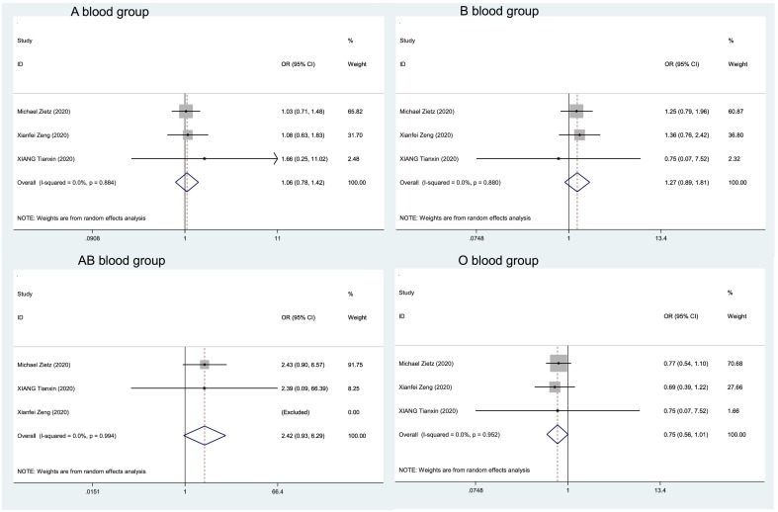
ABO Blood Type and COVID-19 Clinical Outcomes of Severity
Blood type O patients have lower risk of developing severe conditions or death comparing to all other blood types.
USC Mark and Mary Stevens Neuroimaging and Informatics Institute
USC Laboratory of Neuroimaging
loni.usc.edu
22. Wu B-B, Gu D-Z, Yu J-N, Yang J, Shen W-Q. Association between ABO blood groups and COVID-19 infection, severity and demise: A systematic review and meta-analysis. Infect Genet Evol J Mol Epidemiol Evol Genet Infect Dis. 2020;84:104485. doi:10.1016/j.meegid.2020.104485
25. Latz CA, DeCarlo C, Boitano L, et al. Blood type and outcomes in patients with COVID-19. Ann Hematol. 2020;99(9):2113-2118. doi:10.1007/s00277-020-04169-1
26. Zietz M, Zucker JE, Tatonetti NP. Testing the association between blood type and COVID-19 infection, intubation, and death. medRxiv. Published online September 10, 2020:2020.04.08.20058073. doi:10.1101/2020.04.08.20058073
28. Padhi S, Suvankar S, Dash D, et al. ABO blood group system is associated with COVID-19 mortality: An epidemiological investigation in the Indian population. Transfus Clin Biol J Soc Francaise Transfus Sang. 2020;27(4):253-258. doi:10.1016/j.tracli.2020.08.009
29. Hoiland RL, Fergusson NA, Mitra AR, et al. The association of ABO blood group with indices of disease severity and multiorgan dysfunction in COVID-19. Blood Adv. 2020;4(20):4981-4989. doi:10.1182/bloodadvances.2020002623
30. Ray JG, Schull MJ, Vermeulen MJ, Park AL. Association Between ABO and Rh Blood Groups and SARS-CoV-2 Infection or Severe COVID-19 Illness : A Population-Based Cohort Study. Ann Intern Med. Published online November 24, 2020. doi:10.7326/M20-4511

Slide 11
Genetic Association and Underlying Molecular Mechanism
chr3p21.31
Spike protein/Angiotensin-converting enzyme 2 (ACE2)-dependent
https://genome.ucsc.edu/cgi-bin/hgTracks?db=hg38&lastVirtModeType=default&lastVirtModeExtraState=&virtModeType=default&virtMode=0&nonVirtPosition=&position=chrX%3A15560138%2D15602945&hgsid=999532331_w7X8ZCuyabaoaFKFSoyanTQOvDyG
Notes:
Studies have found a strong association between a locus on a specific gene cluster on chromosome three (chr3p21.31) and outcome severity, such as respiratory failure.
Cellular models have suggested an explanation for blood type modulation of infection, evidencing that spike protein/Angiotensin-converting enzyme 2 (ACE2)-dependent adhesion to ACE2-expressing cell lines was specifically inhibited by monoclonal or natural human anti-A antibodies, so individuals with non-A blood types, specifically O or B blood types, which produce anti-A antibodies, may be less susceptible to severe acute respiratory syndrome coronavirus 2 (SARS-CoV-2) infection due to the inhibitory effects of anti-A antibodies.

Slide 12
Thank you, Laboratory of Neuro Imaging (LONI), for this great opportunity!
This work was supported by the National Science Foundation under Award Number 2027456 (COVID-ARC)

